Slide 1
System Development Methods CT00046-3-2
System Development Planning
Part 2

Slide 2
Topic & Structure of the Lesson
Requirement Engineering
Stages
Review Facts Finding Methods
System Requirement Specifications (SRS)

Slide 3
Learning Outcome
At the end of the module, you should able to:
Explain the purpose, structure and scope of modern Information System Development Methodologies and select and justify appropriate methods of analysis, design and implementation for a particular component or application, be it traditional, multimedia or web based.

Slide 4
Key Terms you must be able to use
If you have mastered this topic, you should be able to use the following terms correctly in your assignments and exams:
Explain Requirement Engineering stages
Discuss the benefits and setbacks of various Facts Finding Methods
Create various System Requirement statements.
Risk Management

Slide 5

Information System Requirements
Requirements
A guideline of what the new IS should do to archive its objectives.
High Level Requirement.
Overall goal of the system.
Determined at initial planning stage by the analyst
Low Level Requirements
More detailed functions
Determined by gathering requirements from varies sources.
Later tuned into Systems Requirement Specifications (SRS)

Slide 6
Quick Quiz
What would happen if you don’t collect enough / accurate information before you start your project?
Discuss the problems that you would face later.

Slide 7
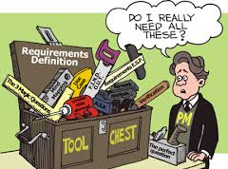
Requirement Engineering Main Activities … a review
RE - Process of gathering, analyzing and finalizing requirements for the project.
AKA; Requirement Gathering, System Investigation.
Requirement Elicitation (Requirement gathering)
Collect data about the old system and the new system to be built
Requirement Compilation
Gathering / merging the collected data into one location
Requirement Validation and Analysis
Narrowing / filtering, keeping only important and achievable requirements.
Output
System Requirement Specification (SRS)

Slide 8

Requirement Engineering (RE)
Basically asking the following questions to gather facts, WHO, WHAT, WHERE , WHEN, HOW , WHY.
Popular RE Techniques;
Interview
Questionnaires / Survey
Observation
Document Review
Data Mining
Brainstorming
Focus Group, etc

Slide 9
Quick Quiz
If you are creating a new website for APU;
Who would you interview?
Who would you send your questionnaires?

Slide 10

System Requirement Specifications (SRS)
Structured collection of information that contains the finalized requirements of a system
Contains finalized requirement for System Design
Popular Requirement groups;
Functional Requirements
Non-Functional Requirements
Architecture Requirements
Business Requirements
System / Technical Requirements
User / Stakeholders Requirements
Security Requirements
User Interface Requirements, etc

Slide 11

Risk Management 11-04-17
Process of identifying potential risk to the project / products and getting prepared for it.
Many projects failed due to;
Developer did not identifying all risks
Developer Ignoring risks
Developer did not prepare ‘backup plan’ for risk
Developer did not monitor risk.

Slide 12
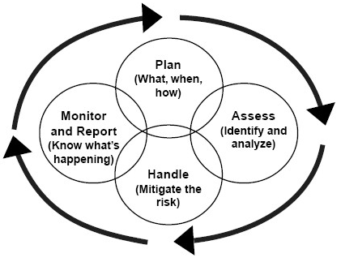
Risk Management Process

Slide 13
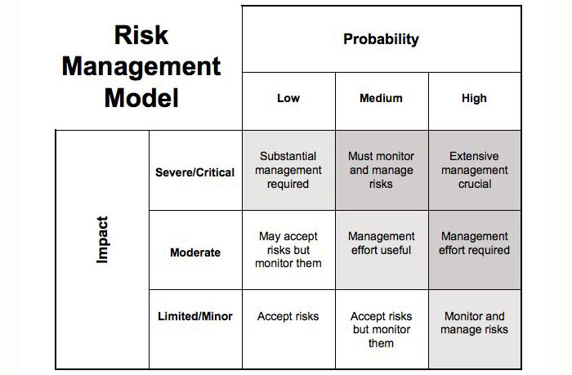
Risk Management Model
Risk is the product of Probability vs impact (Risk = Probability X Impact)

Slide 14

Risk Management Strategies
Risk Transfers
Accept that the risk MAY happen. Transferring the risk to a vendor or customer (who are aware of the risk but willing to face it if it comes).
Risk Avoidance
Accept that the risk MAY happen and taking alternative path to avoid the risk from happening.
Original design may change.
Risk Reduction
Accept that the risk WILL happen and taking additional steps to reduce the risk form occurring.
May increase cost and delay in delivery time.
Risk Acceptance
Accept that the risk WILL happen and implement total solution.
Costly and time consuming.

Slide 15
Summary of Main Teaching Points
RE Stages
Fact-finding techniques
SRS
IT Risk Management

Slide 16
Question & Answer

Slide 17
Next Session
System Analysis – Methods and Tools

Slide 18
Tutorial
Individual Work;
For EACH Requirement Gathering Methods, explain a situation where it CAN BE USED and NOT SUITABLE TO BE USED.
Design a simple questionnaire (using the Likert-scale format) to find out the effectiveness of Webspace-2 in APU.
Group work;
Webspace-2 was built on various requirements.
Write 2 requirement statements for each TYPES you studied here, for Webspace-2
Identify the RISKs involved of you are given a project to upgrade Websapce-2. Show the risk in the Risk Analysis Table.

